Slide 1
Embedded SEED
UART (Universal Asynchronous Receiver Transmitter Communication
Understanding UART Communication Protocol and its implementation on STM32L452RE Controller

Slide 2
Lab Name: A Hardware Communication Protocol Understanding Universal Asynchronous Receiver/Transmitter
Problem Statement: To Understand UART Communication Protocol and Implement the UART Transmission and Reception on STM32L452RE Controller
STM32 Cube IDE Configuration
Objective: The Objecitve of this Experiment is to Help understand UART Communication, its Features and Handle Serial Terminal Software like Docklight.
Output: At the end of this experiment the students will be successfully able to implement UART Communication Protocol on STM32 Mico-controller.

Slide 3
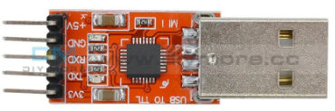
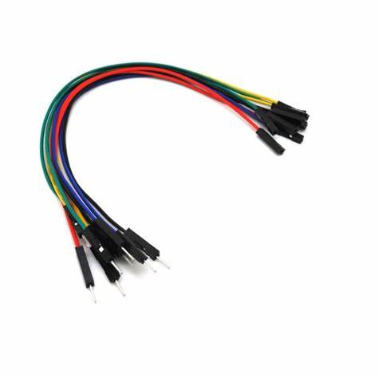
HARDWARE REQUIREMENTS
USB to TTL
2. Jumper Cables (Female to Female)

Slide 4
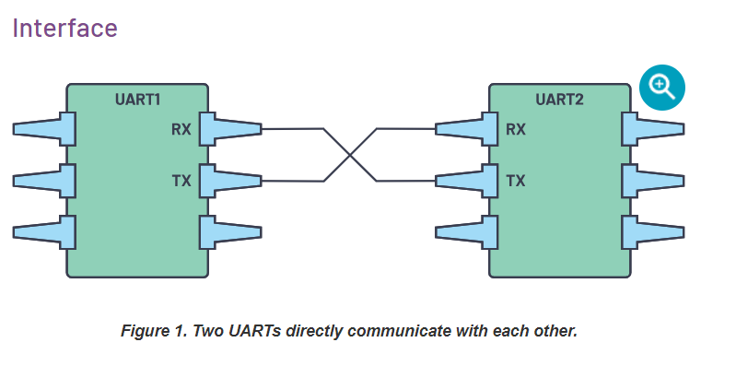
UART, or universal asynchronous receiver-transmitter, is one of the most used device-to-device communication protocols.
Communication protocol plays a big role in organizing communication between devices.
Embedded systems, microcontrollers, and computers mostly use UART as a form of device-to-device hardware communication protocol

Slide 5
The two signals of each UART device are named:
Transmitter (Tx)
Receiver (Rx)
The main purpose of a transmitter and receiver line for each device is to transmit and receive serial data intended for serial communication.
Parameters | Value
Speed | 9600, 19200, 384200, 57600, 115200, 230400, 460800, 921600, 1000000, 1500000
Methods of Transmission | Asynchronous
Min No of Masters | 1
Max No of Slaves | 1

Slide 6
Data Transmission
In UART, the mode of transmission is in the form of a packet. The piece that connects the transmitter and receiver includes the creation of serial packets and controls those physical hardware lines. A packet consists of a start bit, data frame, a parity bit, and stop bits.

Slide 7
Steps in UART Transmission and Reception
Step 1 - The transmitting UART receives data in parallel from the data bus ( From Micro-controller)
Step 2 -
The transmitting UART adds the start bit, parity bit, and the stop bit(s) to the data frame.
Step 3 - The entire packet is sent serially starting from start bit to stop bit from the transmitting UART to the receiving UART. The receiving UART samples the data line at the preconfigured baud rate.

Slide 8
Step 4 - The receiving UART discards the start bit, parity bit, and stop bit from the data frame..
Step 5 - The receiving UART converts the serial data back into parallel and transfers it to the data bus on the receiving end.

Slide 9
HARDWARE CONNECTIONS
TO PC / LAPTOP
PC4 (UART TX
STM32L452RE µC
GND

Slide 10
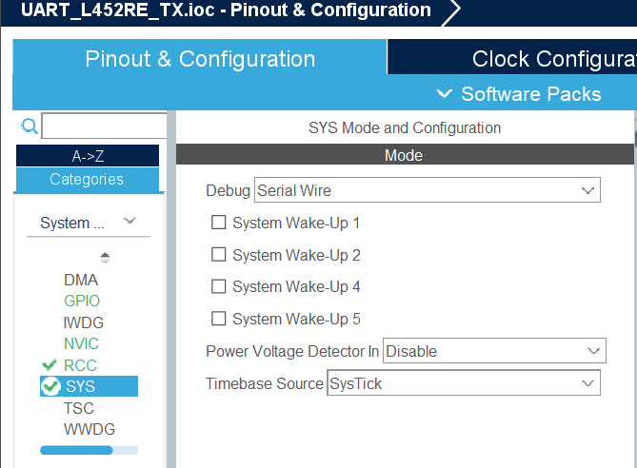
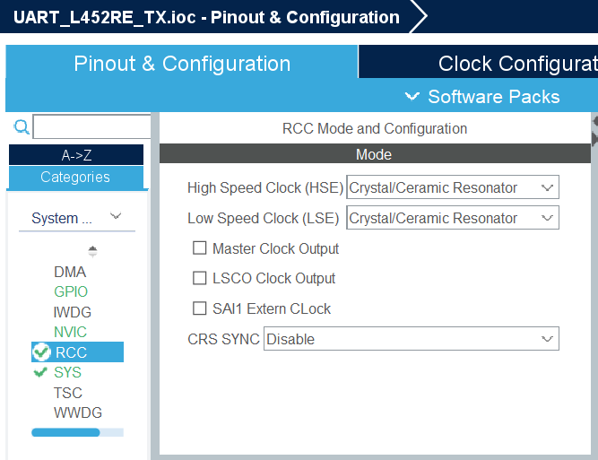
Steps in Configuring STM32 UART Communication Protocol
STEP 1 – Open Cube IDE and Create a new Project
STEP 2 – Configure SYS as Serial Wire and RCC as Crystal Ceramic Resonator

Slide 11
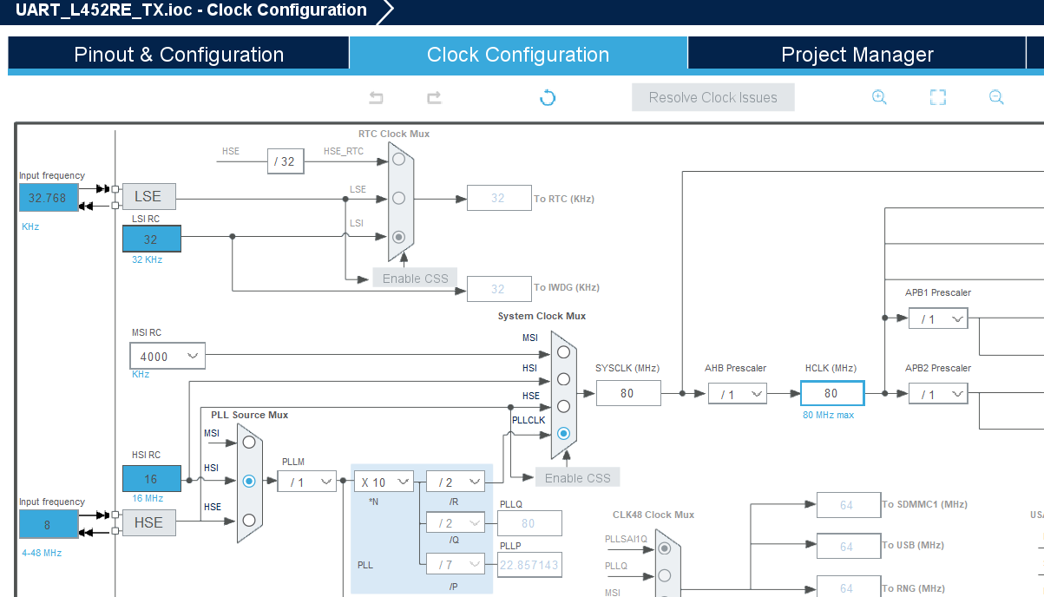
STEP 3 – Configure the Clock Source as 80 MHz and Select the Frequency as Input High Frequency (HIS) as Shown in the Figure

Slide 12
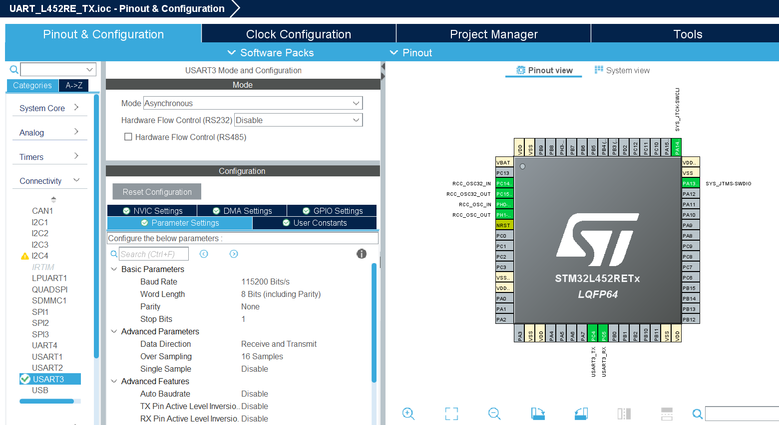
STEP 4 – Click on Connectivity Option. Under Connectivity Select USART3.
STEP 5 – Click On Mode and Select Asynchronous. Keep the Settings as shown in the Figure.

Slide 13
STEP 6 – In the main.c file write the code for UART Transmission and Build and if no errors are present run the Code.

Slide 14

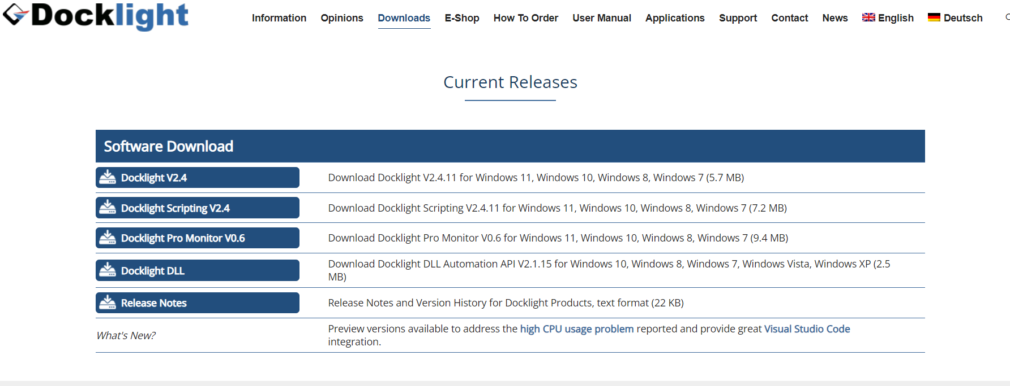
Steps to Install Dock-light Software
Step 1 – Open Google and Type Download Docklight for Windows. Click on the following link.
Step 2 – Once Docklight Website Opens, Select Download Docklight Option as shown in the figure

Slide 15
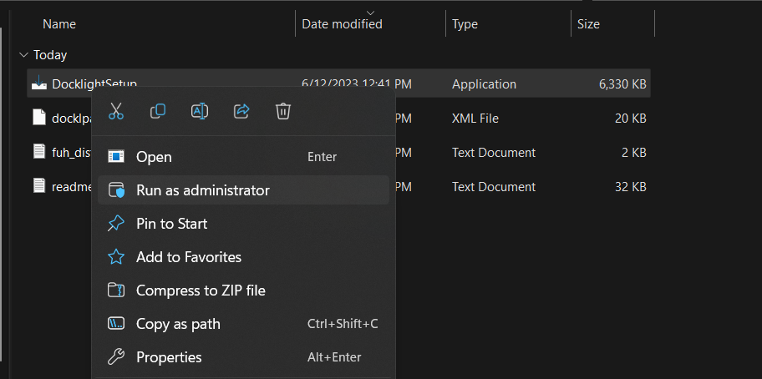
Step 3 – Once Docklight Software is Downloaded, Install the Software. Click Run as Administrator.

Slide 16
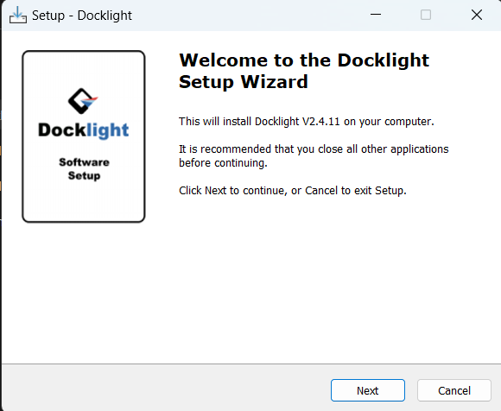
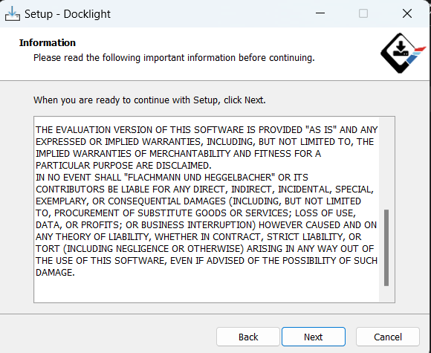
Step 4 – Setup Docklight. Click Next
Read Agreement and Click Next
Step 4 – Setup

Slide 17
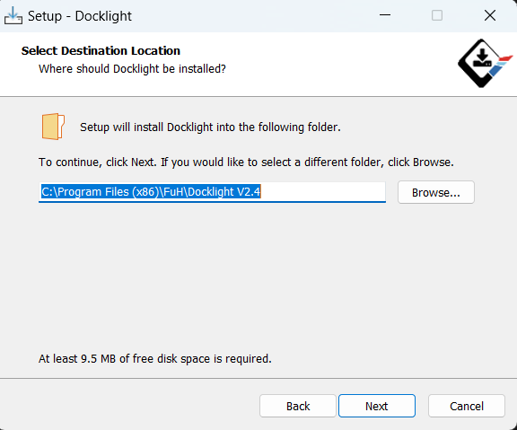
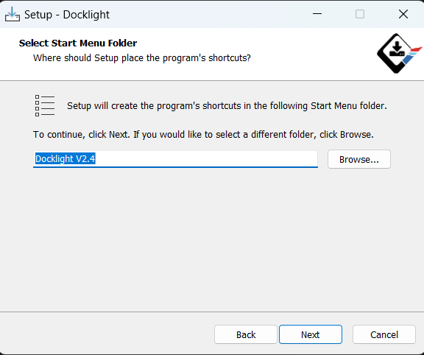
Specify Folder for Installation. Keep the Default Folder and Click Next
Click Next

Slide 18
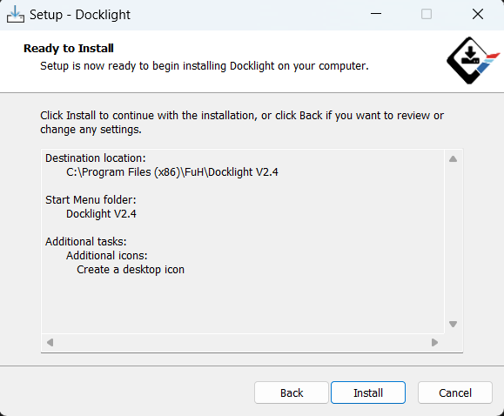
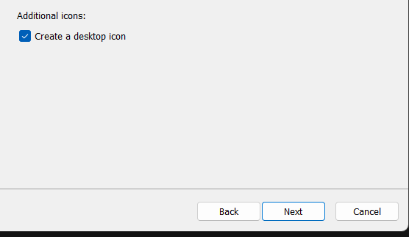
Check on Create Desktop icon and Click Next
Install the Application

Slide 19
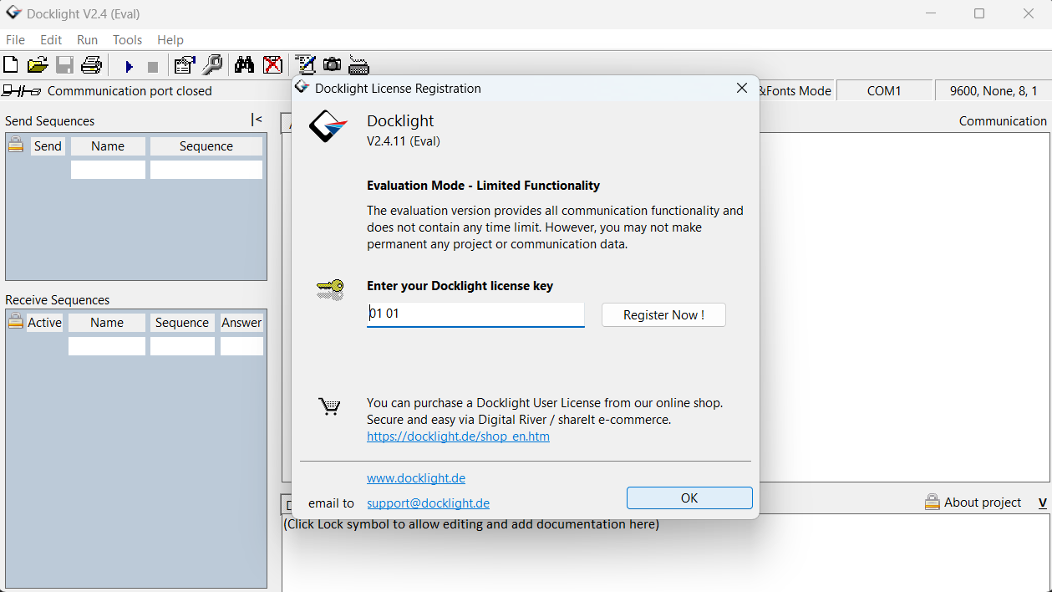
Once Installed, Open Docklight, And click OK when following Message Shows. Double Click on COM1.

Slide 20
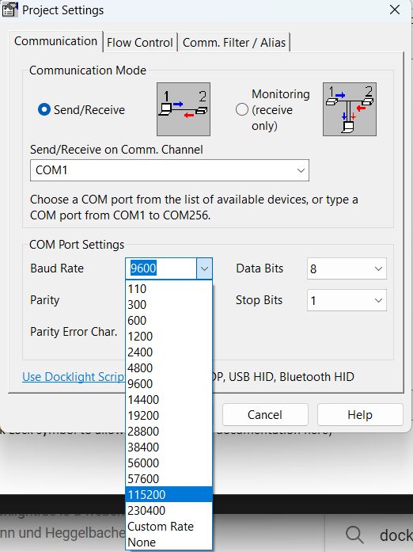
Select the desired COM Port and Select the Baud Rate to 115200 BPS

Slide 21
Click on Run Button

